Slide 1

Sunday, July 15th, 2018
Adult
Sunday School Class
Notes:
Good morning

Slide 2
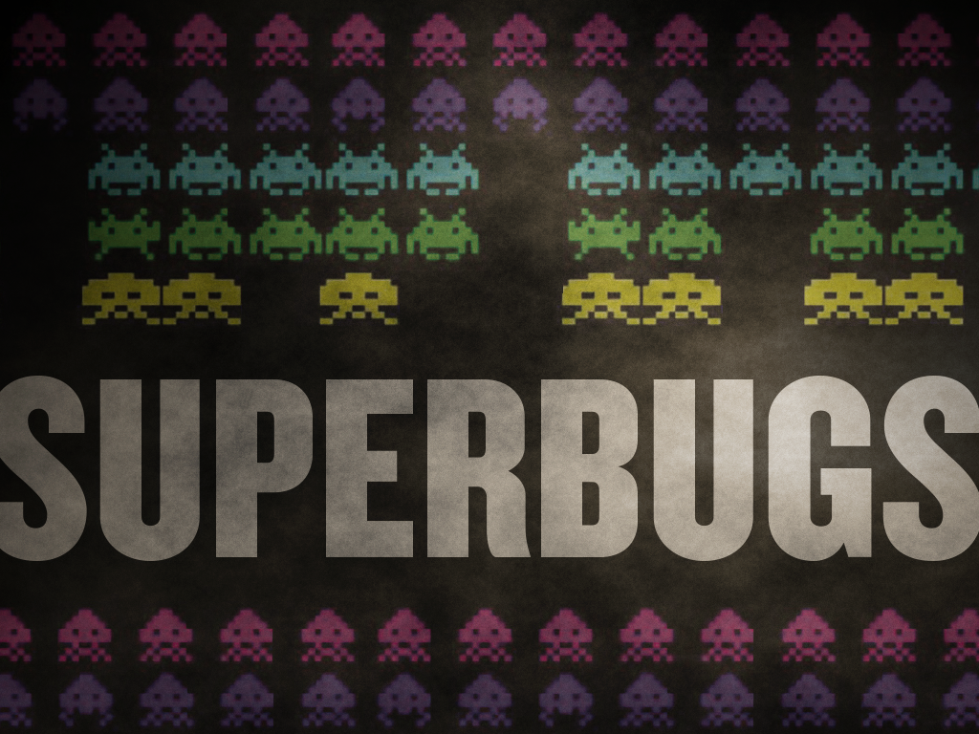
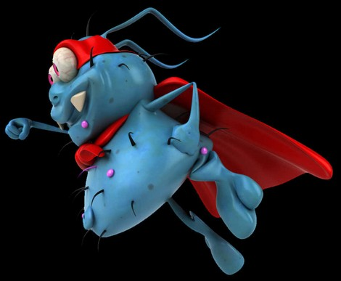
Free Love and the Sex Superbug
Carbapenem-resistant
Enternobacteriaceae
Antibiotic Resistant Bacteria
Notes:
Almost 200 UCLA Medical Center patients my have come in contact with CRE…
… Medically, this is carbapenem-resistant en-tero-bacteria-ceae
… the ‘NIGHTMARE BACTERIA’ - or - “Fatal Superbug”
This exposure and it’s resulting infections lead many experts to believe that, if unchecked, growing issues of superbugs could lead to eminent death for 10m worldwide by 2050.
HOW MANY KNOW WHAT A SUPERBUG IS?

Slide 3
Free Love and the Sex Superbug
Carbapenem-resistant
Enternobacteriaceae
Antibiotic Resistant Bacteria
Notes:
1.7 “Super Bug” - It’s not a medical term, but a common man’s term that represents a dangerous class of microbes (generally bacteria) that have mutated enough to resist the medications used to treat them.
Referred to as: Drug Resistant bugs, and Antibiotic resistant bugs.

Slide 4
Free Love and the Sex Superbug
Carbapenem-resistant
Enternobacteriaceae
Antibiotic Resistant Bacteria
Notes:
2.7 Why do they mutate like this? - Like any living organism, bacteria can mutate as they multiply.
Much like we see in the insect and weed kingdom, the are ‘offspring’ bacteria that have mutated in particular ways to make them resistant to antibiotics. Then, when the antibiotics are introduced, only the bacteria that can resist that treatment can survive to multiply further – reinforcing the line of drug-resistant bugs.

Slide 5
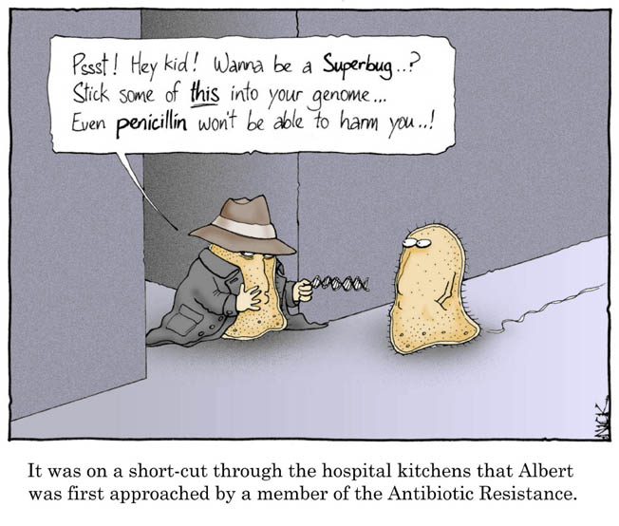
Free Love and the Sex Superbug
Carbapenem-resistant
Enternobacteriaceae
Antibiotic Resistant Bacteria
Notes:
3.7 Why are we hearing so much about superbugs now?
Its an inevitable journey. Ironically enough, our immunity to diseases via inoculations is exactly how superbugs are ‘inoculated’ with antibiotics, and ‘learn’ to defeat/resist their potency!
It wouldn’t be logical that it only works for humans, and for nothing else!
At least 2m people will become infected with antibiotic-resistant bacteria per year in the US. 35% of those are estimated to die from such infections…
… Without additional methods of treating superbugs, that number could reach 10m by 2050.
One study claims that CRE infections were 5x as likely in 2012 compared to 2008.

Slide 6
Free Love and the Sex Superbug
Carbapenem-resistant
Enternobacteriaceae
Antibiotic Resistant Bacteria
Notes:
4.7 How much of a risk is there for a healthy person?
Drug-resistant infections are more common in hospital or other ‘Health Care’ settings. Why?!?! Aren’t these places sanitary!?!?
People already seeking medical attention are likely to have a weakened immune system. This leaves them susceptible to infections. CRE infections have only been seen in health-care settings, according to USA TODAY.
However, MRSA (a wellknown superbug) has certainly been caught outside of hospitals.
There is a very real possible risk of any surgical procedure. According to WebMD, this only occurs in about 1 percent of cases involving surgery.

Slide 7
Free Love and the Sex Superbug
Carbapenem-resistant
Enternobacteriaceae
Antibiotic Resistant Bacteria
Notes:
5.7 What can I do to protect myself?
Because ‘treatment options’ are limited, PREVENTION IS THE BEST CURE.
The CDC urges patients concerned about CRE to stay up-to-date on vaccines, stay healthier overall, and out of medical facilities. Careful hand-washing should be a regular practice…
… and MOST IMPORTANTLY, avoid unnecessary treatments with antibiotics.
– TAKING ANTIBIOTICS WHEN THEY ARE NOT NEEDED IS WHAT CAUSES SUPERBUGS!!!
The CDC claims that antibiotics are “not optimally prescribed” almost 50% of the time. Antibiotics do not fight VIRUSES!

Slide 8
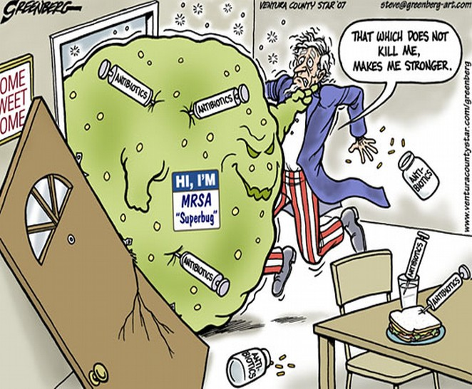
Free Love and the Sex Superbug
Carbapenem-resistant
Enternobacteriaceae
Antibiotic Resistant Bacteria
Notes:
6.7 Are some superbugs more dangerous than others?
Yes. The CDC lists three urgent threats:
1. CRE = 9k infections every year.
2. C. DIFFICILE = 250k infections of life-threatening diarrhea every year.
3. NEISSERIA GONORRHOEAE = 246k cases of drug-resistant STD.
These are followed by 12 more, currently slightly less serious threats, of bacteria that cause diarrhea, meningitis, tuberculosis, and blood infections.

Slide 9
Free Love and the Sex Superbug
Carbapenem-resistant
Enternobacteriaceae
Antibiotic Resistant Bacteria
Notes:
7.7 Aren’t there antibiotics in foods?
Well, yes. Germs that contaminate our foods can also become drug-resistant. Sometimes antibiotics are given to animals to help them gain weight more quickly, and this practice DOES seem to play a role in mutating bacteria.
Example: E.coli causes urinary tract infections, and quite often contaminated chickens can be one of the many cuplrates. Eatingh chicken carrying drug-resistant E.coli can cause UTI that is rendered un-treatable, as there isn’t any way to fight it, other than treating symptoms and riding it out.
Some argue that this E.coli could be originating in humans and making its way to animals through our sewage system.

Slide 10

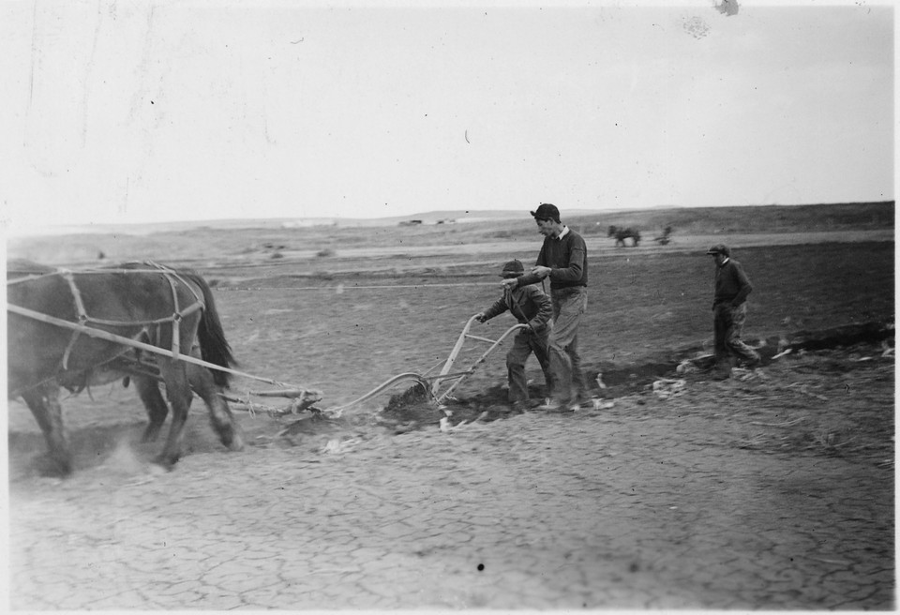
Free Love and the Sex Superbug
Galatians 6
7 Be not deceived; God is not mocked: for whatsoever a man soweth, that shall he also reap.
- You are following in someone’s footsteps… … and someone is following in yours.
Notes:
We aren’t covering this ‘Adult Nightmare’ just to have something to talk about, or to paranoy you everytime you hear the bathroom door cycle without a precursor of hearing the sink faucet dispensing water.
This world has a different take on the Bible passage. How many have ever heard someone say, “It’s karma. It will come back and bite you.”
But the BIBLE DOES NOT TEACH KARMA.
We don’t receive in like measure as we give.
The Bible teaches that we SOW and REAP. You don’t reap in the same proportion that you sow… No one would ever sustain feeding this way.

Slide 11
Free Love and the Sex Superbug
Job 4
8 Even as I have seen, they that plow iniquity, and sow wickedness,
reap the same.
- You are following in someone’s footsteps… … and someone is following in yours.
Notes:
We reap a harvest compared to what little we sow. It multiplies.
Some 10 fold, some 60 fold, and some 100 fold.
Good or Bad, we SOW with our actions, we don’t just deposit and withdraw them.
MANKIND cloaks his words of disobedience by calling it another name.
ALCOHOLISM
ABORTING FETAL TISSUE
ADDICTION
COMPULSION
ADULT ENTERTAINMENT
FREE LOVE

Slide 12
Free Love and the Sex Superbug
Job 4
8 Even as I have seen, they that plow iniquity, and sow wickedness,
reap the same.
- You are following in someone’s footsteps… … and someone is following in yours.
Notes:
SIN NATURE = Psycological Normalcy
LUST = Love/Appreciation
UNBELIEF = Academic enlightenment/reason
…
… But the crop mankind is harvesting simply hasn’t changed.
God’s formula in Joshua has stayed consistant through out the Bible… Don’t confuse ‘legalism’ and ‘earning your salvation’ with OBEY GOD’S COMMANDMENTS AND STATUTES AND LIVE!!!
If you are falling for the ‘Hath God really said’, you are, quite literally falling for the OLDEST TRICK IN THE BOOK!

Slide 13

Free Love and the Sex Superbug
GUESS THE SHAPE!!!
- What is it SUPPOSED to be?
Notes:
Does anyone know what this shape is?

Slide 14
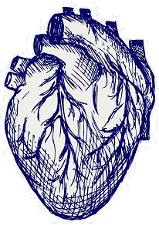
Free Love and the Sex Superbug
GUESS THE SHAPE!!!
- It doesn’t look much like a heart...
Notes:
No. This is not a heart. THIS is a heart.
So, where did this shape come from, and why do we CALL it a heart?!?
Interestingly enough, you’ll never be able to google or wiki the answer. Because they all say the same thing: “Some people believe it is… But we can’t really know.”
One theory was: <” Derived from a SEED. “>
This shape was found on a cyrene coin! One theory is that the traditional heart came was derived from the plant seed of the Silphium plant. This now extinct (for over 2k years) North African plant was found in the ancient city of Cyrene during the seventh century BC. The plant was most commonly used as seasonings, but was also widely used as a contraceptive in ancient Egypt.
Because of it's importance to their economy, they depicted the shape of the seed on their coins. The seeds were distinctly heart-shaped. It is said that because of the use of the plant as a contraceptive, the shape of the seeds became associated with sexuality and eventually with romantic love.

Slide 15
Free Love and the Sex Superbug
GUESS THE SHAPE!!!
- So, what is it supposed to be the shape of?!?
Notes:
Sounds great… but in ancient days, HAVING KIDS was an important deal, as SOMEONE had to harvest, battle, herd sheep and cattle!
Contraception would have been a very BAD thing back then.
While its inception goes back farther than the 1960’s, contraception made it’s mainstream prominence during the ‘Free Love’ movement of the 60’s.
It’s hard to have ‘free love’ when kids keep popping up all over and someone’s got to feed, cloth, and rear them.
From the 1960’s, contraception has now become a medical right that must be funded by the government.

Slide 16
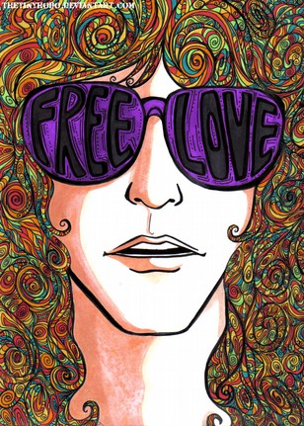
Free Love and the Sex Superbug
GUESS THE SHAPE!!!
- Is ‘BAD’ a shape?!? Because I’m pretty sure ‘Out Of’ is a shape.
Notes:
SEXUAL FREEDOM is a modern term for ‘Violating God’s commandments against fornication, adultery, homosexuality, and lust’.
In ‘53, the ‘I Love Lucy’ prime-time comedy could not use the word ‘Pregnant’.
Seven years later, sexual promiscuity was glamorized by Hollywood, academia, and a growing influence from the hippy culture.
Open-Ended marriages
Co-habitation
Momosexuality
Pedophilia…
Ask yourself this question: Is polygamy illegal? Then why is it ok to sleep with one person at a time?!?
America has had 60 years of FREE LOVE… but the Invoices are starting to pour in.

Slide 17
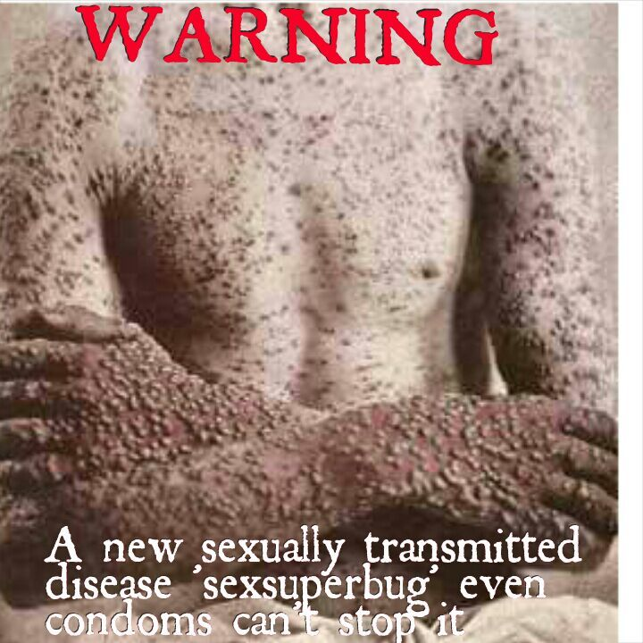
Free Love and the Sex Superbug
YEARLY INVOICE
Genital herpes / HPV … 70m
Chlamydia ……………… 5m
HIV……………………….. 1m
AIDS…………………….. 45k
Hepetitis B…………….. 300k
Syphilis………………… 120k
Porn Addiction……….. 20m
<18 molested…………. 25%
This isn’t karma… it’s SOWING and REAPING.
Notes:
The wages satan pays for sin is still death.
Before we reveal what this has to do with ‘Superbugs’, consider the ‘FRUITS’ of FREE LOVE in the USA:
• 70m cases of genital herpes and HPV
• 5m cases of chlamydia
• 1.1m cases of ghonorrhea
• 1m people with HIV
• 45k people with AIDS
• 300k people with Hepatitis B
• 120k cases of syphilis
• 20m people addicted to pornography
• 25% of U.S. women sexually molested by the age of 18 (Ironically enough, 25% of women over 60 are on antidepressants!)
• 123m Americans affected by a sexually transmitted disease
• 79,914 arrests reported by the FBI for sex crimes OTHER THAN PROSTITUTION. (Factoring 50 crimes for every arrest brings the number to 3,995,700.)
• 50,m abortions
• Multitudes of children born out-of-wedlock
• A minority of children currently being raised with both biological parents in the home

Slide 18
Free Love and the Sex Superbug
‘Sex Superbug Could Be ‘Worse than AIDS’
CNBC.com, April 30, 2013
Notes:
CNBC.com - “Sex Superbug Could Be ‘Worse than AIDS”
“An antibiotic-resistant strain of gonorrhea – now considered a superbug – has some analysts saying that the bacteria’s effects could match those of AIDS.
“This might be a lot worse than AIDS in the short run because the bacteria is more aggressive and will effect more people quickly,” says Alan Christianson, a doctor of naturopathic medicine.
“Even though 30m people have died from AIDS-related causes worldwide, Christianson believes the effects of the gonorrhea bacteria is more direct.

Slide 19
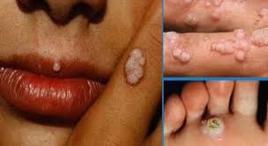
Free Love and the Sex Superbug
‘Sex Superbug Could Be ‘Worse than AIDS’
CNBC.com, April 30, 2013
Notes:
“Getting gonorrhea from this strain might put someone into septic shock and death in a matter of days,” Christianson said, “This is VERY dangerous.”
“It’s an emergency situation,” William Smith, exec director of the National Coalition of STD directors, “As time moves on, it’s getting more hazardous.”
“This gonorrhea strain, HO41, was discovered in Japan two years ago in a 31yr old. Female sex worker who had been screened in 2009. The bacteria has since been found in Hawaii, California, and Norway.

Slide 20
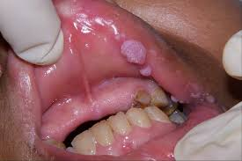
Free Love and the Sex Superbug
‘Sex Superbug Could Be ‘Worse than AIDS’
CNBC.com, April 30, 2013
Notes:
“Because it resists current antibiotic treatment, the strain has been placed in the SUPERBUG category with other resistant bacteria, such as MRSA and CRE.
These superbugs kill about HALF the people they attack, and nearly 1 in 20 hospital patience have become infected with one, according to the CDC.
READY FOR THE RECOMMENDATION?
“People need to practice safe sex, like always.” Christianson said. “Anyone beginning a new relationship should get tested along with their partner. The way gonorrhea works, not everyone knows they have it. And with this new strain, it’s even MORE important than ever to find out!

Slide 21
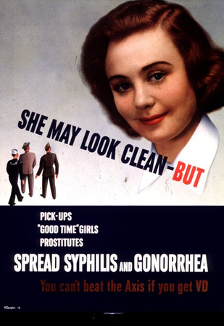
Free Love and the Sex Superbug
‘Sex Superbug Could Be ‘Worse than AIDS’
CNBC.com, April 30, 2013
Notes:
All superbugs must be dealt with before it’s too late! He says.
Yet, in SPITE of this ‘Worldly Wisdom’ of “Just keep doing what you’re doing and be safe… and get checked (in case that doesn’t work)”
… The CRC reports:
“Every year 20m new STD infections happen in the United States. ANYONE can get them.
However, Some groups are DISPROPORTIONATELY AFFECTED by STD’s.
Adolescents and Young Adults
Gay, Bi, & Other Men who have sex with men.
And some Racial/Ethnic Minorities.
Good News is STD’s are preventable!

Slide 22

Free Love and the Sex Superbug
‘Sex Superbug Could Be ‘Worse than AIDS’
CNBC.com, April 30, 2013
Notes:
1. ABSTINENCE – Surest way to avoid Sexual Transmitted Disease is to abstain.
2. Have fewer partners – Agree to only have sex with one person who agrees to only have sex with you.
3. Make sure you both get tested.
4. Get Vaccinated – Some STD’s can be prevented by Vaccines.
WHO SHOULD GET VACCINATED?
Young women (13-26) and young men (13-21)
Gay, Bi, & Men w. Men (up to 26)
Men with compromised immune systems (up to 26)
Many STD’s are curable… All can at least treat the symptoms.
… UNLESS THE STD IS IMMUNE TO TREATMENT.

Slide 23
Free Love and the Sex Superbug
Job 4
8 Even as I have seen, they that plow iniquity, and sow wickedness,
reap the same.
- You are following in someone’s footsteps… … and someone is following in yours.
Notes:
We reap a harvest compared to what little we sow. It multiplies.
Some 10 fold, some 60 fold, and some 100 fold.
Good or Bad, we SOW with our actions, we don’t just deposit and withdraw them.
MANKIND cloaks his words of disobedience by calling it another name.
ALCOHOLISM
ABORTING FETAL TISSUE
ADDICTION
COMPULSION
ADULT ENTERTAINMENT
FREE LOVE

Slide 24

Sunday, July 15th, 2018
Adult
Sunday School Class
Notes:
Lets be in REVIEW this week.
Thank you.

