Slide 1

Adult
Sunday School Class
Sunday, December 31, 2017
Notes:
I told my co-worker that he smelled like UpDog yesterday.
He said, “What’s UpDog?”
I said, “Nothin’ my-man! What’s up wit-chu?”

Slide 2

Adult
Sunday School Class
Sunday, December 31, 2017
Notes:
I told my co-worker that he smelled like UpDog yesterday.
He said, “What’s UpDog?”
I said, “Nothin’ my-man! What’s up wit-chu?”

Slide 3
Adult
Sunday School Class
Sunday, December 31, 2017
Notes:
It’s a beautiful thing to be a soulwinner. To have the privilege of introducing another brother-in-sin to Christ the Redeemer.
Jason spoke quite a lot on this Wednesday night… at least, that’s what spoke to my heart the most, anyway.
While Baptists traditionally scoff at lifestyle evangelism, I do believe it is pointless to show up at someone’s doorstep or open your NT with them on a bench at the mall if you have no love for God or His commandments at home.
It will come out a shallow message every time.

Slide 4
Adult
Sunday School Class
Sunday, December 31, 2017
Notes:
I like the song I heard this year:
“If you have named the name of Jesus,
If you’re known as one of His.
Remember that the world is watching,
To see how your victory is.
What you are, speaks so loud,
The World can’t hear what you say.
They’re looking at your walk,
Not listening to your talk,
They’re judging from your actions every day.
Don’t believe, you’ll deceive,
By claiming what you’ve never known.
They’ll judge what they see, and know you to be,
By looking at your life alone.”

Slide 5

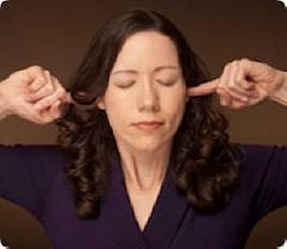
Unreachable ?!
Adult
Sunday School Class
Sunday, December 31, 2017
Notes:
However, I’d like to point out something that maybe you’ve already come to know:
You may not have an opportunity to present the gospel every time you meet someone right off the bat.
1. Sometimes the opportunity simply does not present itself.
2. Sometimes the lost person is outright NOT accepting invitations at this time.
3. Sometimes you have ZERO influence or connection to the person.
We’re starting off a new year, and here’s some ideas for 2018 that you might consider trying… EXTRA witnessing.
<< CAUTION >> THIS ONLY WORKS IF YOUR LIFE MATCHES YOUR WORDS!

Slide 6

EXTRA Ways to witness
7 And thou shalt teach them diligently unto thy children, and shalt talk of them when thou sittest in thine house, and when thou walkest by the way, and when thou liest down, and when thou risest up.
8 And thou shalt bind them for a sign upon thine hand, and they shall be as frontlets between thine eyes.
9 And thou shalt write them upon the posts of thy house, and on thy gates.
- Deuteronomy 6
Notes:
Deuteronomy 6
4 Hear, O Israel: The LORD our God is one LORD:
5 And thou shalt love the LORD thy God with all thine heart, and with all thy soul, and with all thy might.
6 And these words, which I command thee this day, shall be in thine heart:
7 And thou shalt teach them diligently unto thy children, and shalt talk of them when thou sittest in thine house, and when thou walkest by the way, and when thou liest down, and when thou risest up.
8 And thou shalt bind them for a sign upon thine hand, and they shall be as frontlets between thine eyes.
9 And thou shalt write them upon the posts of thy house, and on thy gates.

Slide 7
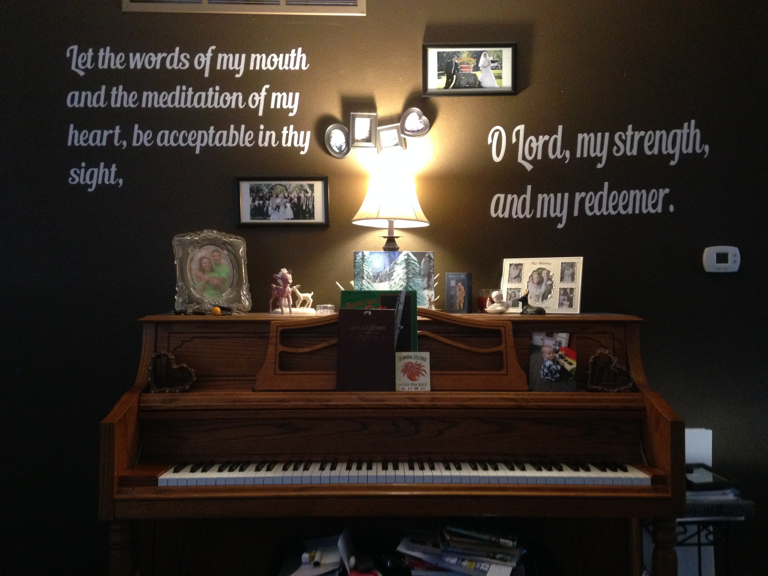

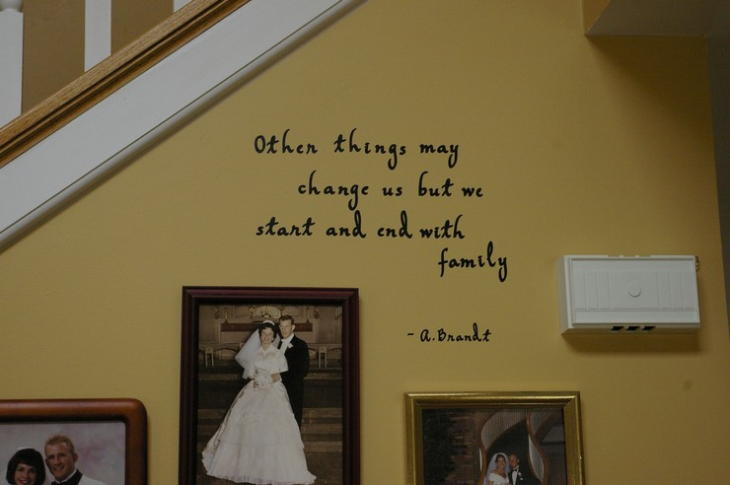
EXTRA Ways to witness
Wall Art
Compulsory reading… We can’t help it!
Notes:
1. Wall Quotes and House Decorations - Decorating your house with scriptures and other similar decorations is not only a great way to witness to all of your guests and neighbors; it’s also something God actually commanded the Israelites to do. Consider this passage in the Old Testament:
You can put wall quotes in just about every room of our home. You can buy these quotes on eBay or Amazon, or etsy or you can find a local vinyl shop to make them for you.
They are made of vinyl, and they simply stick to your wall. They only cost about $6-20 per quote, and most online sellers will do custom orders for you (if they don’t have a scripture you’d like).

Slide 8
EXTRA Ways to witness
Wall Art
“Sometimes we Christians get all upset when someone takes down the 10 Commandments from a courthouse. Is it hanging in YOUR home?”
Compulsory reading… We can’t help it!
Notes:
Think about it: A wall quote is usually far less money than a painting or picture frame, and it reveals God’s wonderful truth!
And, unlike having a verse in your closed Bible, it will be read by everyone who comes in the room. It’s COMPULSORY.
[[[ ILL – I’ll never forget sitting in the hallway waiting for my demerits in college… and reading the Scripture verses on the walls like:
Proverbs 15:10 “Correction is grievous unto him that forsaketh the way: and he that hateth reproof shall die.”
Other ways you can decorate your house include the following:
Garden flags with scriptures, crosses, and such on them.
Nativity scenes during the holidays, instead of Santa or pagan decorations
Paintings of religious scenes
10 commandments stone or plaque display in your yard or on your wall
QUOTE: “Sometimes we Christians get all upset when they take down the 10 commandments from some public building. Question: How many of you have the 10 commandments posted in your own home?” - Adrian Rogers

Slide 9

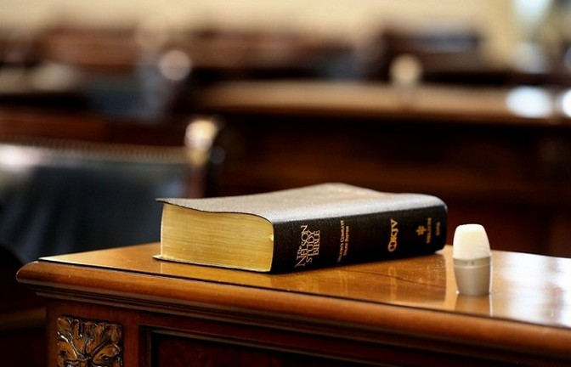
EXTRA Ways to witness
B.Y.O.B
*Bring Your Own Bible
Notes:
2. Bible in Your Office or Work Area - Another easy way for you to witness to others about Jesus is to show people how much you value the Word of God. Consider having a Bible on your desk at the office, in your home, in your work area. You can even keep a copy of the Bible in your car. Of course, you can use other decorations, too.
By doing this, you’re showing others that you read the Bible regularly and that you hold God’s Word in high esteem. It will also be handy in case you have the opportunity to witness to someone verbally. You can also get in a quick reading or devotional during lunch.
I worked for a guy who had a Bible on his desk. And I was always encouraged when I would get to work early enough to find him reading it. It would discourage me when he would swear along with the unsaved at work, or would lose his temper… but it would encourage me again when he would be quick to apologize for his actions and confess them as ungodly.

Slide 10
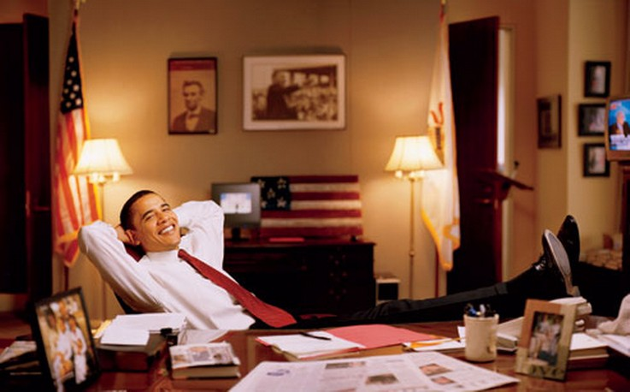
EXTRA Ways to witness
B.Y.O.B
*Bring Your Own Bible
Notes:
2. Bible in Your Office or Work Area – Say what you want ABOUT THE PRESIDENCY OF EX-PRESIDENT BARRACK Obama, BUT CHECK OUT THIS RARE PHOTO…
…
I WAS SHOCKED. DO YOU SEE WHAT I SEE ON HIS DESK?
While i’VE YET TO SEE ANY PROOF THAT HE ACTUALLY READ IT ON ANY REGULAR BASIS, I WAS PRETTY PLEASED TO SEE IT’S PROXIMITY AND PRESENCE IN THE PRESIDENT’S STUDY.
Sadly, THIS SEEMS TO BE THE ONLY PICTURE I COULD FIND OF ANY PRESIDENT WITH A Bible ON HIS DESK.

Slide 11
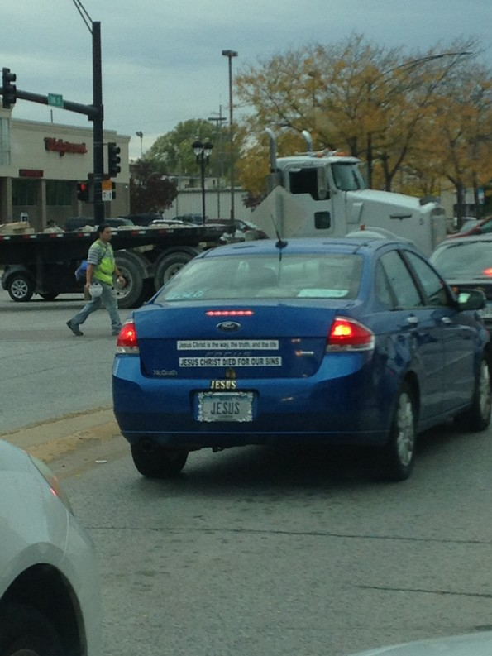
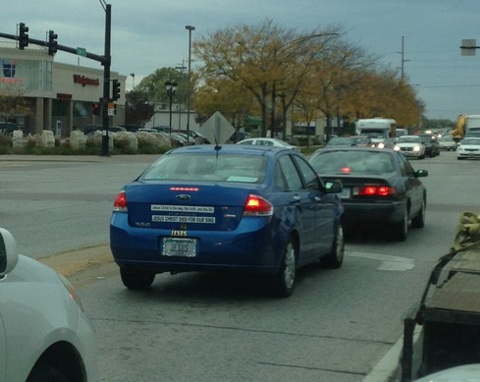
EXTRA Ways to witness
Traveling Billboard
People have to look at SOMETHING besides their phones in traffic!
Notes:
3. Decorations for Your Car (Radio, Bible) - Decorating your car with classy symbols or bumper stickers is also a great way to share the gospel with other drivers. Just make sure you don’t suffer from excessive road rage or speeding, for that would be a horrible testimony!
Here are things you can do with your car to share Jesus:
Hang a cross from the mirror
Bumper sticker or vinyl decoration with a scriptural quote or the name of Jesus
Front tag or rear tag with Christian symbols or scriptures.
Keeping your radio stations programmed to Christian music or good preaching stations is a great idea. When the car mechanic gets in to service the vehicle, he’s going to hear a bit of something.
This is a Ford ‘Focus… on Jesus’

Slide 12



EXTRA Ways to witness
Gospel
Tracts
Often called ‘Little Preachers’ because their compact message can reach those who won’t come to church.
Notes:
4. Gospel Tracts - Gospel tracts are small pieces of paper with the gospel message printed or written on them. You can get them from most churches, and you can also find them in printable form on the internet.
There are lots of opportunities for you to give these out. For example, you can give them out to your cashier at the grocery store, to people soliciting money on the street (perhaps with a small donation), in public areas, and so forth. All you have to do is smile and say, “Hello. May I give you this?” Most people will agree to take it.
You could even take a day to write a personal story about what Jesus has done for you, and then add a short section on how to be saved.
Gospel tracts may seem outdated, but I’ve heard many people talk about being saved from a gospel tract! Charles Spurgeon used to write scriptures and messages on paper and drop them onto crowded streets, hoping that someone would pick them up and believe on the Lord Jesus Christ for salvation.
When you pay your check at a restaurant, leave a tip for the waiter inside of a gospel tract. Tip well.

Slide 13

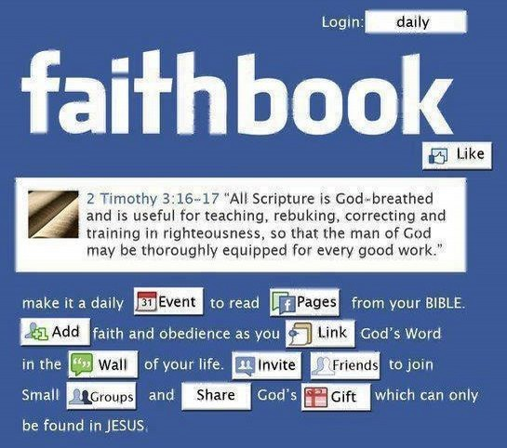


EXTRA Ways to witness
Is Someone Looking?
Don’t Be Two-Faced
Notes:
5. Social Media/Online - Many people have blogs, social media accounts, and so forth. What a perfect opportunity to stand up for Jesus Christ! I’m not saying you MUST have a social media account, but if you already have a blog or social media presence, why not use that space to tell others about Jesus? Talk about church events. Talk about how much God means to you.
Post scriptures on your account or on your profile. Share helpful articles and videos that explain God’s truth so that your friends and family will notice and have an opportunity to be saved. Share funny stories. There are many opportunities to really impact your followers, family, and friends. The ungodly sure use it to spread their junk. I say let’s use it to spread Jesus!
Also talk about your shortcomings and how thankful you are that Christ died to pay the penalty for your sins.
However, don’t use the same account to show pictures of you drinking beer with your friends, having cleavage pop out of your shirt, and all the other nonsense that people post on Facebook or Twitter. It goes against the very Bible you’re trying to preach!
Sometimes just posting a simple, “I’m praying for you” on someone’s wall can actually have a huge impact for encouragement or conviction!

Slide 14
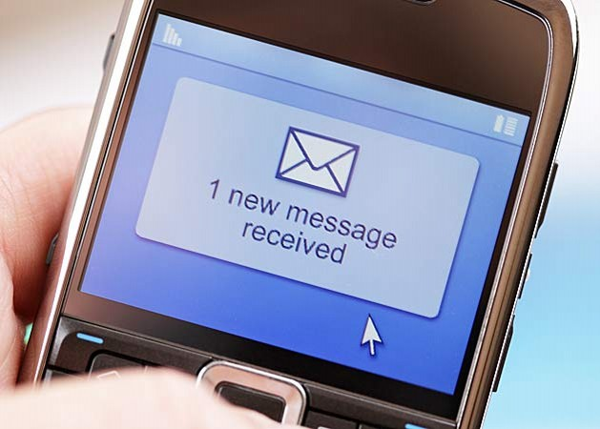

EXTRA Ways to witness
Text a Text
“I’m praying for you today” - or - “I read this verse and it made me think of you: --verse--”
Notes:
6. Text Messaging - Even if you don’t want to verbally share the gospel on the phone, you can always use text to send scriptures, share articles, invite people to church. Text messaging is a great way to talk to others about Jesus, or invite them to a church event.

Slide 15
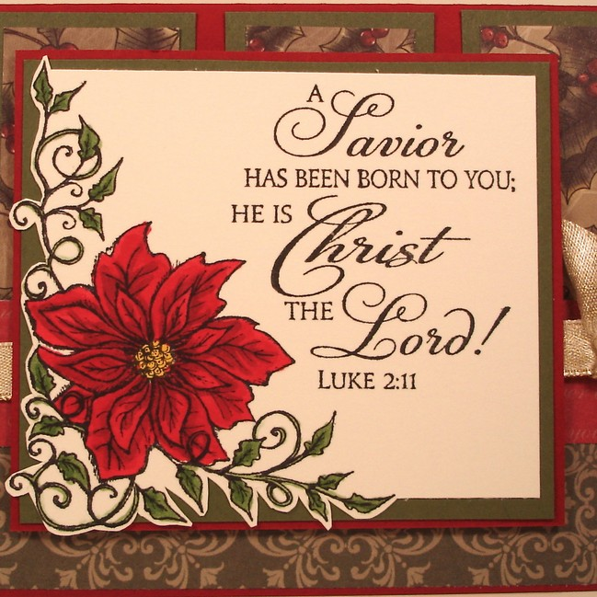
EXTRA Ways to witness
Cards and Letters
Did you know… people READ handwritten letters?!?
Notes:
7. Holiday Cards - If you send out cards for birthdays, Christmas, or other holidays, you have a choice to buy cards that have scriptures in them.
Otherwise, consider writing a scripture in the message of the card. That is a great way to share God’s word in a friendly way. It helps put people’s mind back on the most important thing in the universe: Our Lord and Savior Jesus Christ.
Honestly, just a simple hand-written letter with your testimony or Scripture has a MASSIVE impact these days. Handwritten letters are so rare that many marketing agencies are attempting to mimic handwritten ‘fonts’ to get people to open the envelope and see what’s inside!

Slide 16
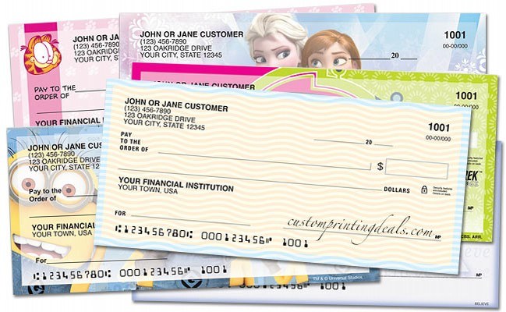
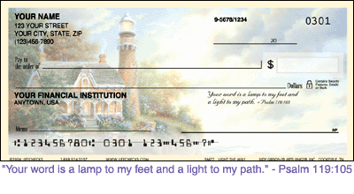
EXTRA Ways to witness
Checks
A personalized message
Keep in mind the next time you re-order checks for the year
Notes:
CHECKS – Many of us will be ordering new checks this year…
… Did you know that many check printing companies will print personalized text on checks?!? While this may be only so many lines long, my wife and I order ours with Scripture verses on the actual check.
Every time I pay my bills, the people cashing, handling, and processing the checks are forced to notice and read Scripture.
… Needless to say, this makes it very important that my bills get paid on-time.
If you are in a position to have business cards printed, why not print a Scripture reference on the back to let people know that you stand with Christ?

Slide 17
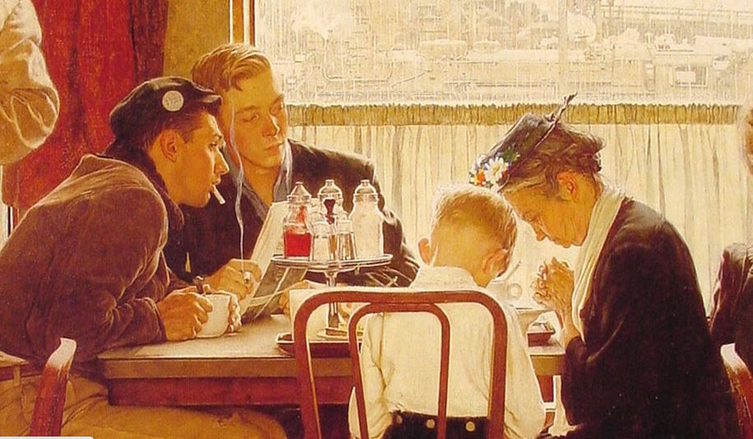
EXTRA Ways to witness
Pray in Public
Thanksgiving Prayer – by Norman Rockwell
Notes:
8. Praying for Meals at Work, Restaurants - We should never pray a vain prayer for the sake of making ourselves appear “pious and holy” before others. Jesus warned against making prayers for this purpose:
“And when thou prayest, thou shalt not be as the hypocrites are: for they love to pray standing in the synagogues and in the corners of the streets, that they may be seen of men. Verily I say unto you, They have their reward. But thou, when thou prayest, enter into thy closet, and when thou hast shut thy door, pray to thy Father which is in secret; and thy Father which seeth in secret shall reward thee openly” (Matthew 6:5-6).

Slide 18
EXTRA Ways to witness
Pray in Public
Thanksgiving Prayer – by Norman Rockwell
Notes:
Jesus isn’t condemning all forms of public prayer, however, for even He prayed publicly:
John 6:11 “And Jesus took the loaves; and when he had given thanks, he distributed to the disciples, and the disciples to them that were set down; and likewise of the fishes as much as they would.”
Consider that Jesus prayed both in private, such as in the garden of Gethsemane as well as in public, like the healing of Lazarus, for example:

Slide 19
EXTRA Ways to witness
Pray in Public
Thanksgiving Prayer – by Norman Rockwell
Notes:
John 11
41 Then they took away the stone from the place where the dead was laid. And
Jesus lifted up his eyes, and said, Father, I thank thee that thou hast heard me.
42 And I knew that thou hearest me always: but because of the people which
stand by I said it, that they may believe that thou hast sent me.
43 And when he thus had spoken, he cried with a loud voice, Lazarus, come forth.
Instead, Jesus is just warning against using prayer as a PRETENSE to appear “holy” or super religious, with the main goal being an attempt to win favor with men.

Slide 20
EXTRA Ways to witness
Pray in Public
Thanksgiving Prayer – by Norman Rockwell
Notes:
However, genuinely praying is a great way to witness to others about your faith in Jesus! Think about it: Suppose you sit down in a crowded office to have lunch, but you stop, bow your head, and say a quick prayer privately. Someone may be watching you out of the corner of their eye, and your prayer may speak to their conscience.
Even if you’re with a coworker or acquaintance who is non-religious, you could say something like, “Excuse me while I give thanks to the Lord,” or “Do you mind if I give thanks for this meal?” Most people will consent. Just don’t do it in an “I’m holier than you” kind of way.
There have been times that I’ve forgotten to give thanks for a meal, and then I looked over and noticed my wife praying privately. When I saw that, it immediately rebuked me!

Slide 21
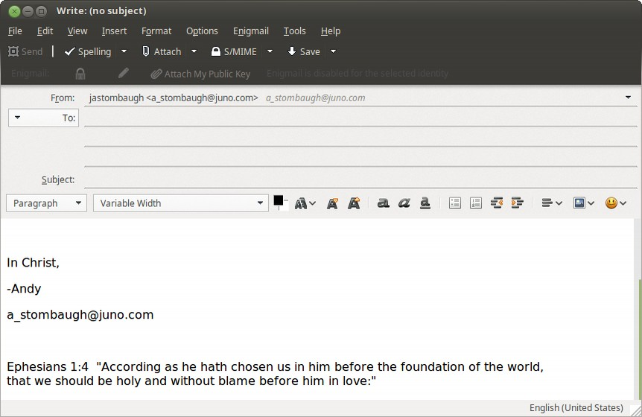
EXTRA Ways to witness
email Signatures
- It can’t be read if it isn’t written. Impact the algorithms for Christ!!!
Notes:
9. Email Signatures - If you use email often, you can usually create “signatures,” which is just a short phrase or paragraph that will automatically post at the end of every message you write. Why not put a scripture like John 3:16 in that signature and say, “This is my favorite Bible verse,” or something similar. Alternatively, you could just say something about Jesus.
In addition, you can even choose email addresses with something about Jesus in it. It’s a quick and easy way to share the gospel without being “preachy” or “pushy.”
… But this also has a much bigger impact than you would normally think. Did you know:

Slide 22
EXTRA Ways to witness
email Signatures
- It can’t be read if it isn’t written. Impact the algorithms for Christ!!!
Notes:
9. Email Signatures – ILL – Officeworker who brought his own spoons.
By including keywords, such as “Jesus Christ”, and “Savior”, and “Lord Jesus”, you include these words in the algorithms google uses to search your communications and, “IN THE INTEREST OF CUSTOM TAYLORING ADVERTISING TO THE MAXIMUM TARGETED AUDIENCE” google will consequently include images for products, items, pictures, quotes, and other such things in future searches your recipient may make online.
:-P

Slide 23
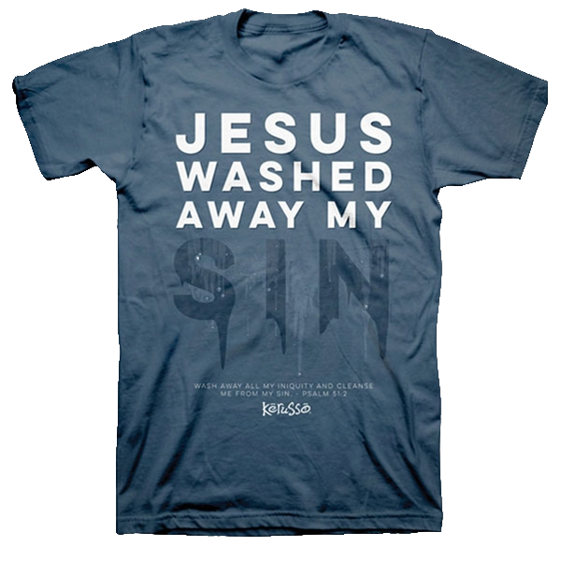

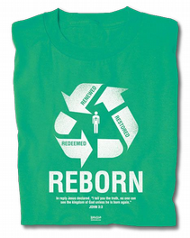
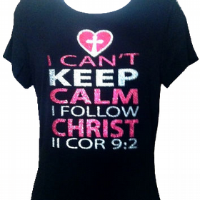
EXTRA Ways to witness
Clothing
People are walking billboards anymore, PAYING to advertise for companies!!!
Notes:
11. Clothing/ Apparel with Quotes - Another easy way to witness without speaking is to wear clothing with scripture, crosses, or the “Jesus Fish” symbol on them. There are plenty of hats, t-shirts, tote bags, backpacks, jewelry, and more.
I’m not saying that your entire wardrobe has to be like this, or that you must wear this every day. I certainly don’t. But isn’t this an easy way to share Jesus? I mean, a tastefully designed hat with a cross isn’t tacky. Most people are already sharing SOMETHING on their clothing. People wear clothing with NIKE swooshes various logos, and everything else.
Why not have at least a hat or a couple of shirts that represent the most important being in the world, who offers salvation freely to whosoever believes on Him? Shouldn’t we be willing to represent Jesus? However, I would warn against getting tattoos in this same way. God discourages that practice. (see Leviticus 19:28)

Slide 24

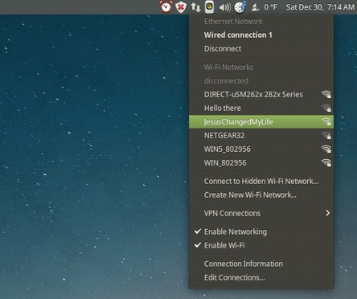
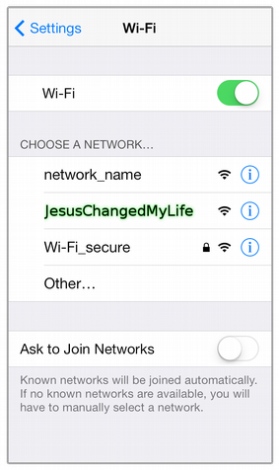
EXTRA Ways to witness
WiFi
Change your SSID to something that preaches everytime someone scans for wifi networks
Notes:
12. Jesus Saves ROUTER ID - When I set up the WI-FI router in my house, I couldn’t help but notice some of the network names in my neighborhood that showed up:
- FBI SURVEILLANCE VAN
- GET YOUR OWN WIFI
- SYSLINK
I had an idea: Why not name MY router something to tell others about Jesus? So I named my WI-FI connection “Jesus Saves.” Anytime someone searches for internet signals to connect to, they’ll see this name.
It’s simple, yet it may speak to someone one day. Who knows how the Lord may use that?
A few years ago someone asked me if I could fix their laptop. Windows was running too slow to do anything with. I turned it on it it’s running ‘Windows – Virus edition!’ This was a shop computer for looking up parts on the internet. So I wiped it and installed linux. The password was “salvationinjesusalone”. Every time that mechanic boots up his laptop, or installs software, or allows updates, or accesses ANYTHING requiring authorization, he must enter this password.

Slide 25
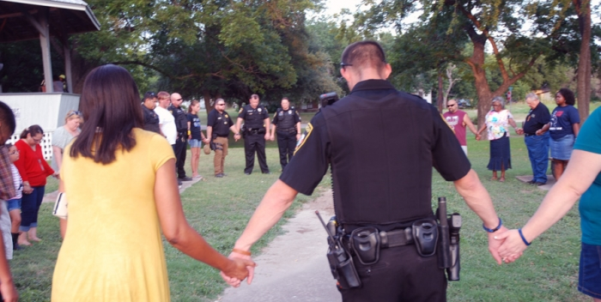
EXTRA Ways to witness
Witnessing
To give testimony to; to testify; to attest (1913 Webster’s Dictionary)
Notes:
13. Letting Your Light Shine - Last but not least, we can witness silently in the way that we lead our daily lives. Jesus told us to let our light shine before others: “Let your light so shine before men, that they may see your good works, and glorify your Father which is in heaven” (Matthew 5:16).
When we treat people with respect, are faithful and loving to our spouses and families, help out those in need, and stand for righteousness in a wicked world, it can do wonders. Someone once said that “A glowing Christian testimony is worth an entire library full of arguments.”
Let’s share our faith in how we live our lives, and let’s tell people how glad we are to have Jesus. Let’s not be walking contradictions. When we make a mistake or sin, let us be quick to admit fault and tell others that what we did was wrong, and that we sinned against God in doing “such and such.”
We should always be ready to share the gospel with anyone we can. Jesus said this: “But whosoever shall deny me before men, him will I also deny before my Father which is in heaven” (Matthew 10:33). We should preach the gospel to every creature, and that involves using words. Keep in mind, there are many extra ways to share the gospel! Sometimes without even using words.

Slide 26

EXTRA Ways to witness
Happy New Year
See you in 2018

