Slide 1

Name Five
~ Focus Round ~
Notes:
Name 5

Slide 2

Name Five
Things that will be seldom used due to technology
Notes:
Name 5

Slide 3

House of Cards
Notes:
MSN.com published an interesting article that hit the news this week...
CDC: 'Alarming' increase in STDs
© REUTERS/Tami Chappell
The Centers for Disease Control and Prevention (CDC) headquarters in Atlanta. Sexually transmitted diseases like chlamydia, gonorrhea and syphilis increased dramatically in 2014, according to the U.S. Centers for Disease Control and Prevention.
In 2014, 1.4 million cases of chlamydia were reported, accounting for the highest “number of annual cases of any condition ever reported to the CDC,” according to the report released on Tuesday. The CDC estimates that nearly 20 million new STD infections happen each year in the U.S., with the majority affecting 15 to 24-year-olds.

Slide 4
House of Cards
Notes:
Reports of gonorrhea and syphilis also increased in 2014. There was a 2.8% increase in chlamydia since 2013, and reports of syphilis, which has three stages, increased for the most infectious stages of the disease by 15.1%.
There was a particularly “troubling” increase in syphilis infections among men, according to the report.
“While rates have increased among both men and women, men account for more than 90 percent of all primary and secondary syphilis cases,” according to the report.
Gay and bisexual men are most at risk for syphilis infections, according to the report. Men who reported that they had sex with other men accounted for 83% of male cases where the partner’s sex was reported.

Slide 5
House of Cards
Notes:
"STDs affect people in all walks of life, particularly young women and men, but these data suggest an increasing burden among gay and bisexual men,” Jonathan Mermin, director of CDC’s National Center for HIV/AIDS, Viral Hepatitis, STD, and Tuberculosis Prevention, said in a statement.
The CDC report noted that STDs like chlamydia and gonorrhea many times have no symptoms, so testing is key to a diagnosis. According to the report, “undiagnosed STDs cause more than 20,000 women to become infertile each year.”
The Big Question: WHY are STD rates so high!?

Slide 6
House of Cards
Notes:
Is it because immorality has grave consequences?
Is it a byproduct of the modern American culture’s enablement for sexual activity among youth?
Is it the judgement of God warned about in the Scriptures?
Is it just ‘Everyone picking on the gays... even the STD’s! Somebody HASHTAG sifilis!
The increase in STDs is in many ways...
... a result of cuts in funding to public health clinics, Gail Bolan, director of CDC’s Division of STD Prevention, told NBC.

Slide 7
House of Cards
Notes:
"Most recently, there have been significant erosions of state and local STD control programs," Bolan said. "Most people don't recognize that the direct clinical care of individuals with sexually transmitted diseases is supported by state and local funds and federal funds."
Surprised?!? The problem is not going away because we simply are just not throwing enough tax dollars at it!? Ok. I’ll bite. HOW MUCH MONEY is it going to cost to simply do away with the problem completely?!?
Or is that along the lines of, “How much money do we need to spend to totally annihilate poverty?!?
Follow @MaryBowerman on Twitter.

Slide 8

House of Cards
Notes:
Let’s face it. The farther any society strays from the Pure Truth of the Word of God, the more it is going to collapse like a house of cards.
We’ve witnessed marriages collapse in divorce or riddled with unfaithfulness.
Children fold in various addictions.
Gay unions erode on the holy institution of marriage created by God.
But the remarkable thing is... that there is a solution! A way of exiting the present spirit of this world’s system and escaping its self-destruction.

Slide 9
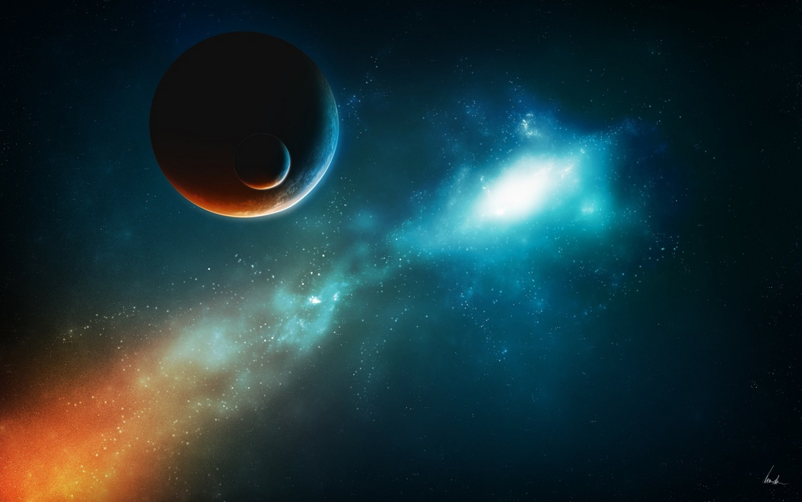
16 For by him were all things created, that are in heaven, and that are in earth, visible and invisible,
- Colossians 1
Notes:
It’s through the person-hood of the Lord Jesus Christ!

Slide 10
whether they be thrones, or dominions, or principalities principalities, or powers: all things were created by him, and for him:
- Colossians 1

Slide 11
17 And he is before all things, and by him all things consist.
- Colossians 1
Notes:
Jesus called it being BORN AGAIN... like a miraculous second birth!
This time being born of the Spirit of Christ, with a new relationship with God, a new name, a new purpose, a new promise, and a new eternal destiny! A new creature!
Everyone starts out with a carnal heritage, but anyone can enjoy a change in Christ Jesus!

Slide 12
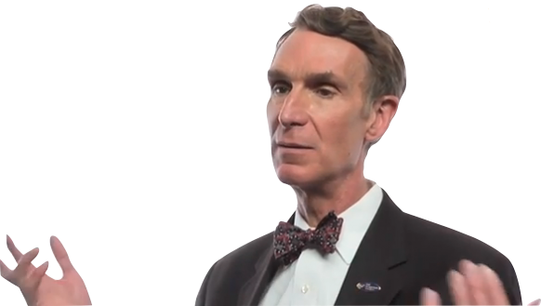
Where is the Center of the Universe?
Notes:
This is Thanksgiving week. I’m excited about it for many reasons.
But if I can, let me share with you some fun and interesting things I found this week.
First off... I tried ‘googling’ the following question:
“Where Is The Center Of The Universe?”
... well, I googled lots of follow up questions, and each of the answers I got really surprised me at just how far science has come. While we turn our attention to Thankfulness this season, let me share a few amazing scientific discoveries.

Slide 13
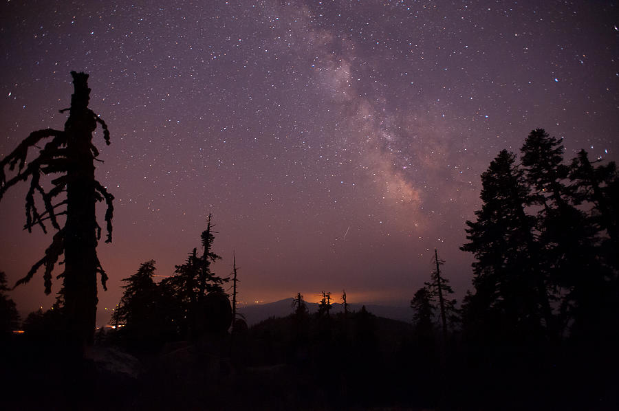
1 ¶ In the beginning God created the heaven and the earth.
- Genesis 1
Notes:
We are familiar with the Creation account.

Slide 14
2 And the earth was without form, and void; and darkness was upon the face of the deep. And the Spirit of God moved upon the face of the waters.
- Genesis 1

Slide 15
¶ And God said, Let there be light: and there was light.
- Genesis 1

Slide 16
¶4 And God saw the light, that it was good: and God divided the light from the darkness.
- Genesis 1

Slide 17
5 And God called the light Day, and the darkness he called Night. And the evening and the morning were the first day.
- Genesis 1

Slide 18
6 ¶ And God said, Let there be a firmament in the midst of the waters, and let it divide the waters from the waters.
- Genesis 1
Notes:
We’re going to come back to this in a few minutes, but let me first point out something pretty cool here.
What is the first thing God made?! - Light.
Now wait a minute... God doesn’t make the sun, moon, stars and planets until later... But, yet, what did God tell us He made first?

Slide 19

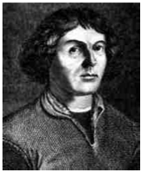
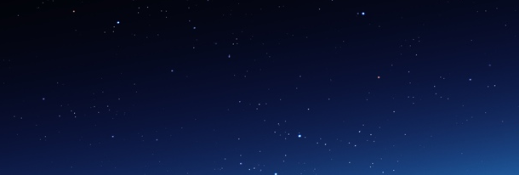
Copernican Principle of Mediocrity
The earth is NOT central to the universe
Notes:
There is a closely held concept among Astrophysicists they call ‘the Copernican Principle of Mediocrity’.
That is to say, the universe is homogenous... the same everywhere, and as far as we can tell, has no boundaries.

Slide 20
Copernican Principle of Mediocrity
The earth is NOT central to the universe
Notes:
Polish astronomer Nicolaus Copernicus’s 1543 book, On the Revolutions of the Heavenly Spheres, moved Earth from being the center of the Universe to just another planet orbiting the Sun.
Since then, astronomers have extended the idea and formed the Copernican Principle, which says that our place in the Universe as a whole is completely ordinary. (ie, not special or purposeful)
Although the Copernican Principle has become a pillar of modern cosmology, finding conclusive evidence that our neighborhood of the Universe really isn’t special has proven difficult.

Slide 21



anthropo/centrism
All things are for man’s sake
Notes:
Let me, at this point, interject another concept…
... anthro-po-centrism...

Slide 22
anthropo/centrism
All things are for man’s sake
Notes:
Could it really be that when God said, “Let us make man in our image, after our likeness: and let them have dominion over the fish of the sea, and over the fowl of the air, and over the cattle, and over all the earth, and over every creeping thing that creepeth upon the earth.”...
... that, rather than the notion that we were an after thought, its more like the Lord created this planet with us in mind?
2 Corinthians 4:15 - “For all things are for your sakes, that the abundant grace might through the thanskgiving of many redound to the glory of God.”
The earth certainly seems to be the center of attention in Scriptures...

Slide 23
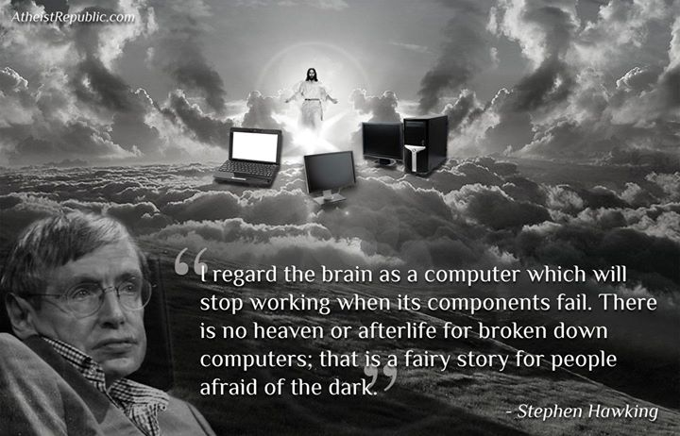
anthropo/centrism
All things are for man’s sake
Notes:
Stephen Hawking - a well known physicist and atheist seemed to almost stumble upon the truth when he wrote his book ‘A Brief History of Time’.
“Now at first sight, all of this evidence that the universe looks the same whichever direction we look in, might seem to suggest there is something special about our place in the universe. In particular, it might seem that if we observe all other galaxies to be moving away from us, then we must be at the center of the universe. There is, however, an alternate explanation: the universe might look the same in every direction as seen from any other galaxy, too. This, as we have seen, was Friedmann’s second assumption. We believe it only on the grounds of modesty: it would be most remarkable if the universe looked the same in every direction around us, but not around other points in the universe! The observable evidence shows the earth as the center of the universe.”

Slide 24
Where is the Center of the Universe?
Notes:
Holding fast to this Copernican Principle, the basic answer I found in the scientific realm was basically this...

Slide 25
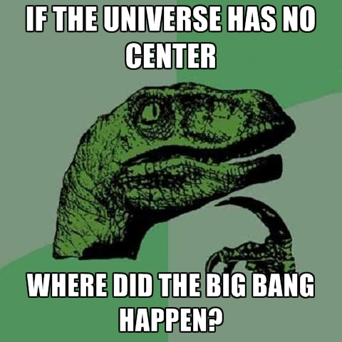
There is no center
?
Notes:
Holding fast to this Copernican Principle, the basic answer I found in the scientific realm was basically this...
The universe must not HAVE a center.
But how can that be?
The troubled concept says: “How can there be a center of something if that something didn’t first exist? If the big bang CREATED space, it couldn’t have happened IN space, because it wasn’t created yet, right!?”

Slide 26
There is no center
?
Notes:
In other words:
“I am going to build a new log house.
I am going to need to use the logs from the old log house to build the new log house…
… but I have to leave the old log house standing until the new log house is built.”
Sounds kinda like a government program, doesn’t it?

Slide 27
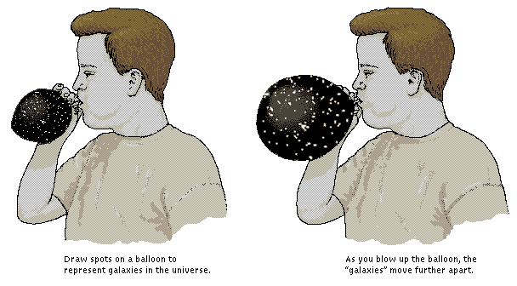
Like Spots on a Balloon
Notes:
From what I can tell, the popular explanation seems to be spots on a balloon.
Blow air in, latex expands, and the dots get farther apart...
... and since our galaxies are drifting farther apart, there is no center.
... I admit, this was a poor analogy for me, because I kept finding myself pointing at the balloon saying, ‘But I can see the center of that! So where is the ‘center’ of the universe!?’
When I asked the dinosaurs question, ‘then WHERE did the big bang happen?’ something pretty incredible turned up.

Slide 28
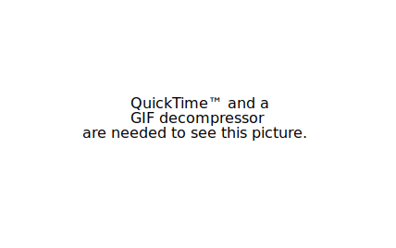
Expanding Universe
The earth is NOT central to the universe
Notes:
In among the ‘evidences of the Big Bang’ comes the ‘Expanding Universe’.
It would seem that our galaxies are, indeed, drifting farther and farther apart.
The concept is (assuming that it has been expanding all along, and at pretty much the same rate as we’ve been able to observe it)... at some point the galaxies must have been a lot closer together...
... and at some point, along the lines of 14 billion years ago, it must have all been touching and part of the same mass of..., well, mass.
... but there STILL doesn’t seem to be a ‘WHERE’ it all began. Because oddly enough, when the radiation levels all across the universe seem to be, as best as we can observe, homogenous (or about the same temperature) its hard to point to a hot center and cooler outer... indicative of such a ‘bang’.
So, the solution:
1. Then, it couldn’t have been a bang... or
2. No, then it must have just banged EVERYWHERE all at the same instant!
Well, now... do you REALLY expect me to believe that all existence came about everywhere all at the same instant?!?
... ISN’T THAT WHAT I’VE BEEN TELLING YOU!?!?
But that’s not all... the second reason gets even better. How many know that light travels in waves?

Slide 29
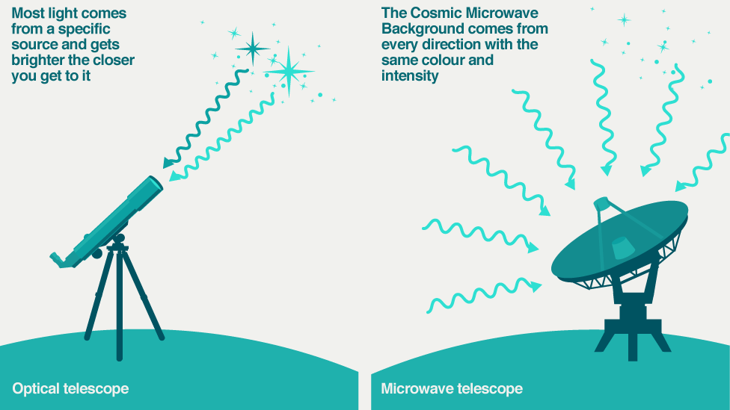
the afterglow of the Big Bang
‘The Heavens declare the Glory of God!’
Notes:
4. Capturing the afterglow of the Big Bang
Maggie Aderin-Pocock explains that ripples in the Cosmic Microwave Background hint at the starting conditions that seeded stars and galaxies. Image: ESA/Planck.
Transcript (PDF 208 Kb)
We can't see it with the naked eye, but some of our telescopes can. Our eyes actually only see a fraction of the light in the Universe. As well as visible light, there are other kinds of light, such as X-rays, infrared light, ultraviolet light, radio waves and microwaves. They have shorter or longer wavelengths than visible light.
After the Big Bang, the whole Universe was flooded with incredibly bright light. As the Universe has expanded, that light has stretched into microwaves.
A microwave telescope can see this ancient light from the very beginning of the Universe. In fact, a view through a microwave telescope shows the whole sky filled with a glow, day and night. This glow is called the Cosmic Microwave Background.
When I asked Why the Big Bang, the article above appeared as one of the ‘evidences’ for it.

Slide 30
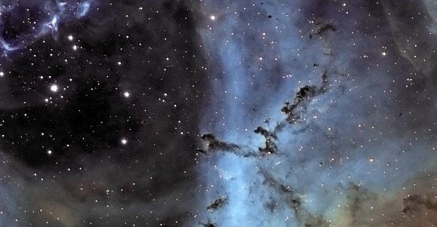
the afterglow of the Big Bang
‘The Heavens declare the Glory of God!’
Notes:
Do you remember what we read first thing this morning? Genesis 1...
... what was the first thing God made?
What is the first thing God made?! - Light.
Now wait a minute... We know Scripture records that God doesn’t make the sun, moon, stars and planets until later... But, yet, what did God tell us He made first?
This had me so excited!!!
At some point, we will have to do a lesson on Anti-matter!

Slide 31
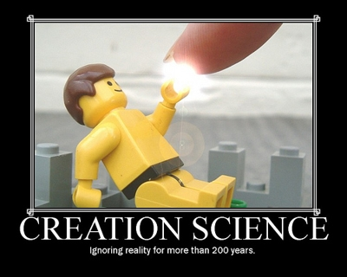
Believe it or not, that lego man was NOT designed, engineered, or created from machinery in any way.
Notes:
Because nothing says the Bible was ignorant like:
The universe was created everywhere equally all at once.
And the evidence for this is that there is light everywhere, homogeneous Not a hot center and cooler outer.

Slide 32
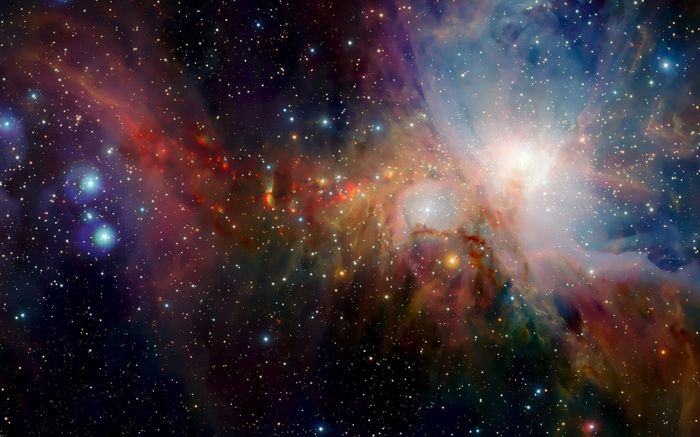
14 Knowing that he which raised up the Lord Jesus shall raise up us also by Jesus, and shall present us with you.
- 2 Corinthians 4

Slide 33
15 For all things are for your sakes, that the abundant grace might through the thanksgiving of many redound to the glory of God.
- 2 Corinthians 4
Notes:
Redound = excess, over-abound!

